Slide 1

Customer Churn Prediction
This analysis is to understand customers data and predict their churn rate in using the telecommunications service.

Slide 2
The aim of this project is to analyze ConnecTtel customer's data to understand and build a robust prediction system to accurately forecast customer churn to overcome this challenge and improve retention strategies.

Slide 3
Customer Data for Analysis
These are 21 data points that we are going to be using for this analysis and they are listed below:
CustomerID
Gender
Senior Citizen
Partner
Dependents
Tenure
Phone Services
Multiple Lines
Internet Service
Device Protection
Tech Support
Streaming TV
Streaming Movies
Contract
Paperless Billing
Payment Method
Monthly Charges
Total Charges
Churn
Online Security
Online Backup

Slide 4

Methods for Analysis
The methods that we used to analyze this data is:
Data Wrangling
Data Pre-processing
Feature Engineering
Machine Learning – Supervised Learning (Categorical Data)

Slide 5
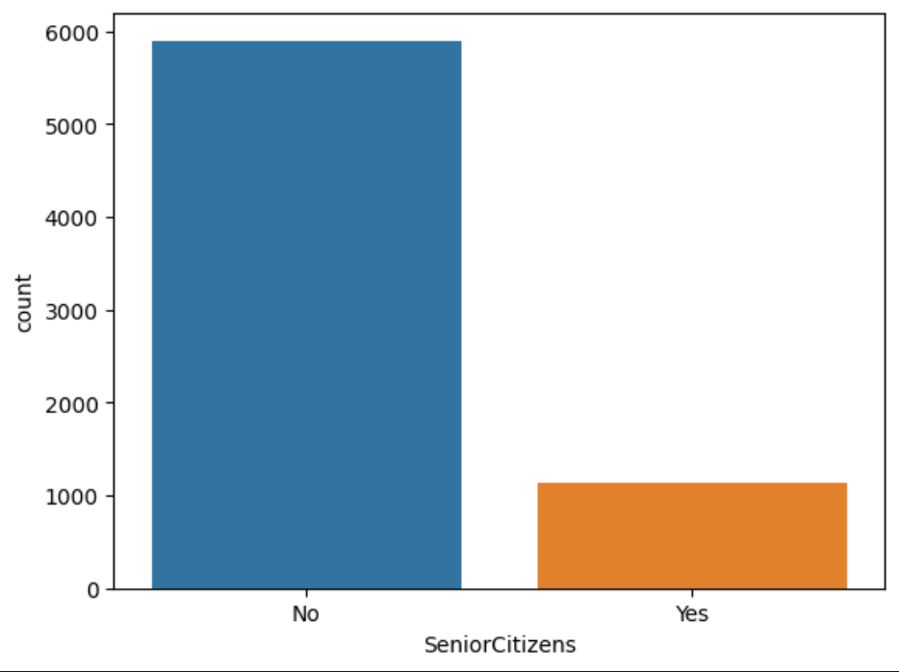
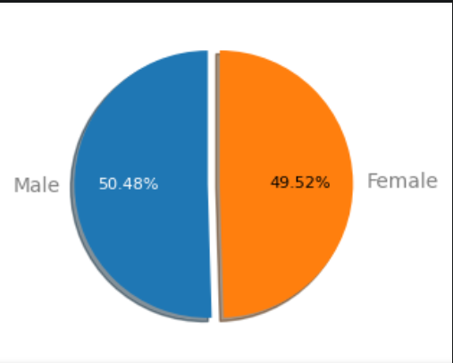
Univariate Analysis
Studying the data individually
There are higher Non-Senior Citizen compared to Senior Citizen
Female are fairly less than the Male

Slide 6
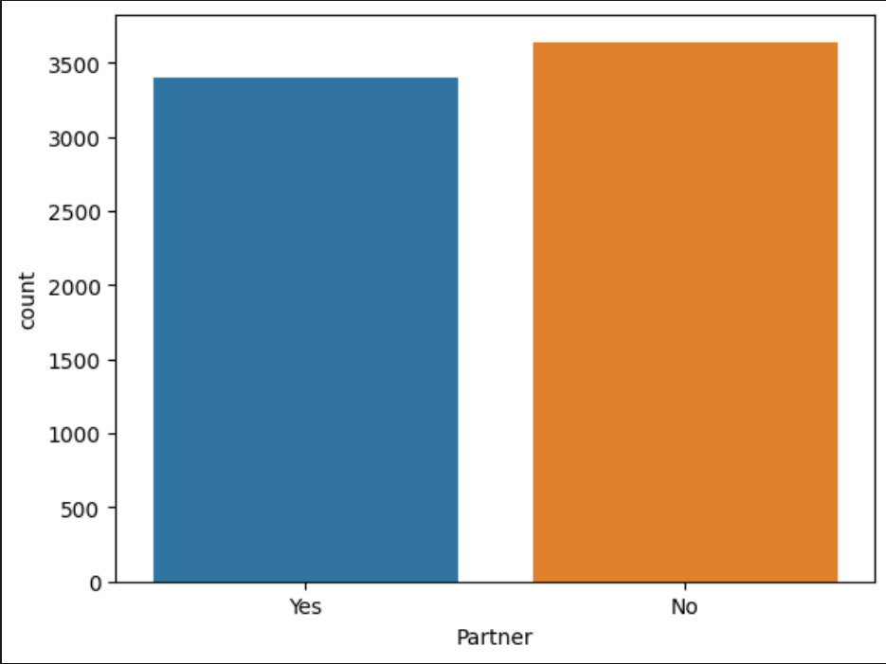
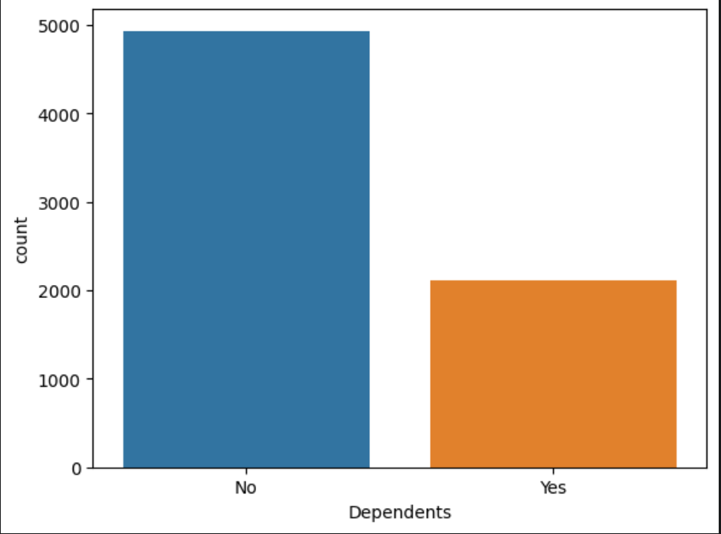
There are more customers without partners than customers with partners
There are more customers without dependents

Slide 7
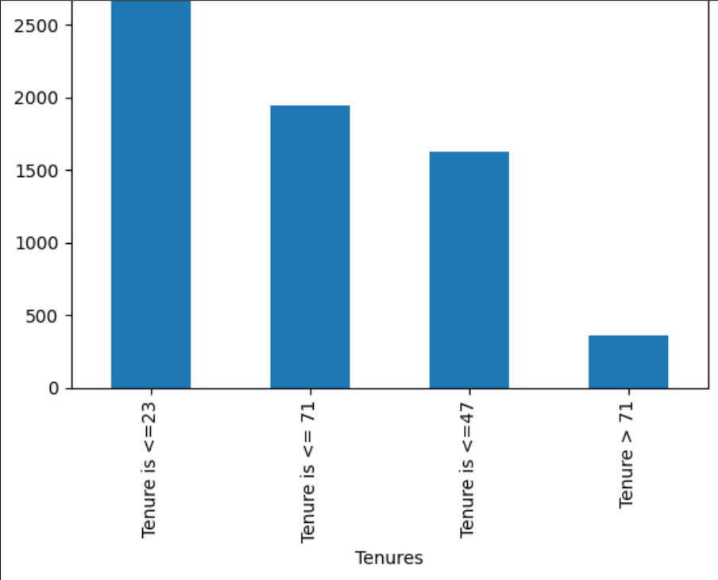
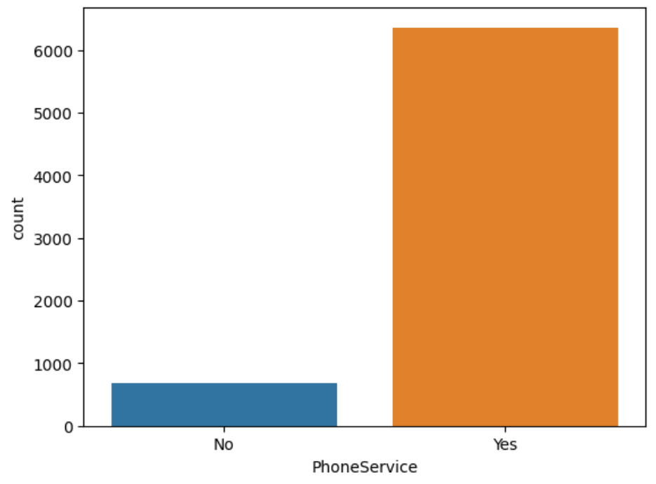
There are more customers whose longevity is less than 23
There are more customers who subscribe to Phone services

Slide 8
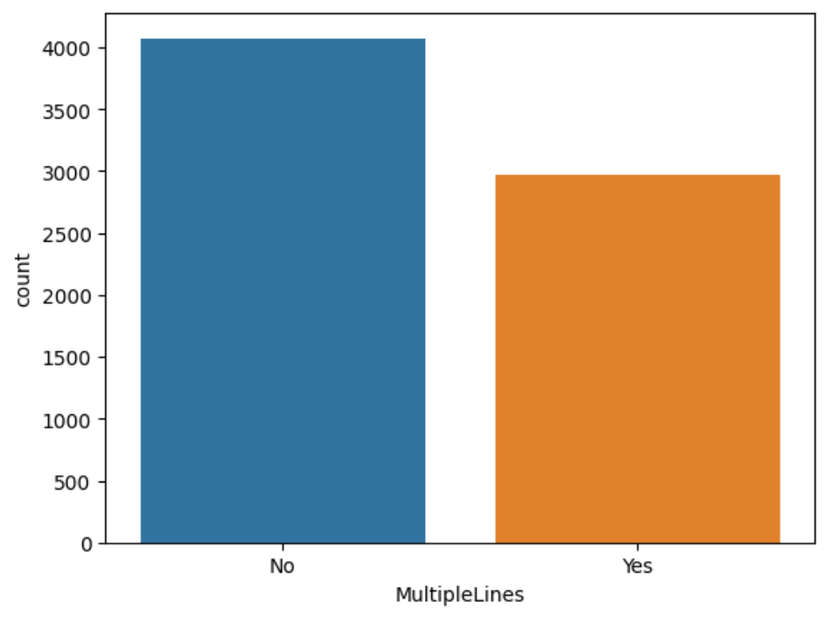
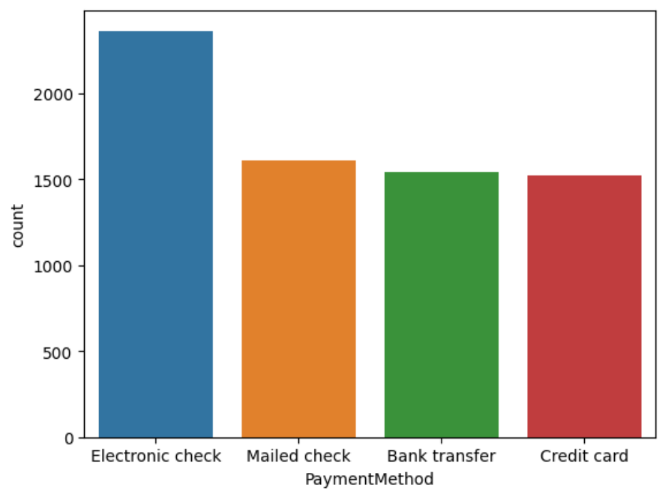
There are more customers who subscribe to Multiple Lines
Most customers use "Electronic Check" as their payment method

Slide 9
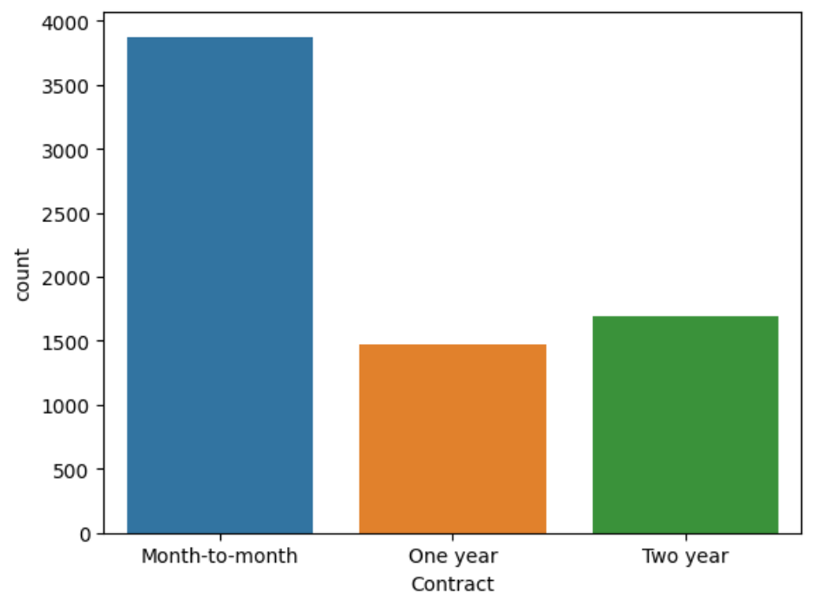
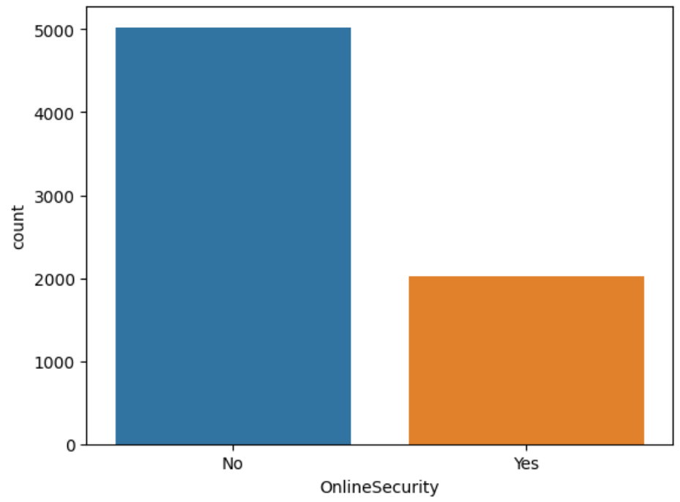
There are more customers on month-to-month subscription
There are less customers using online security

Slide 10
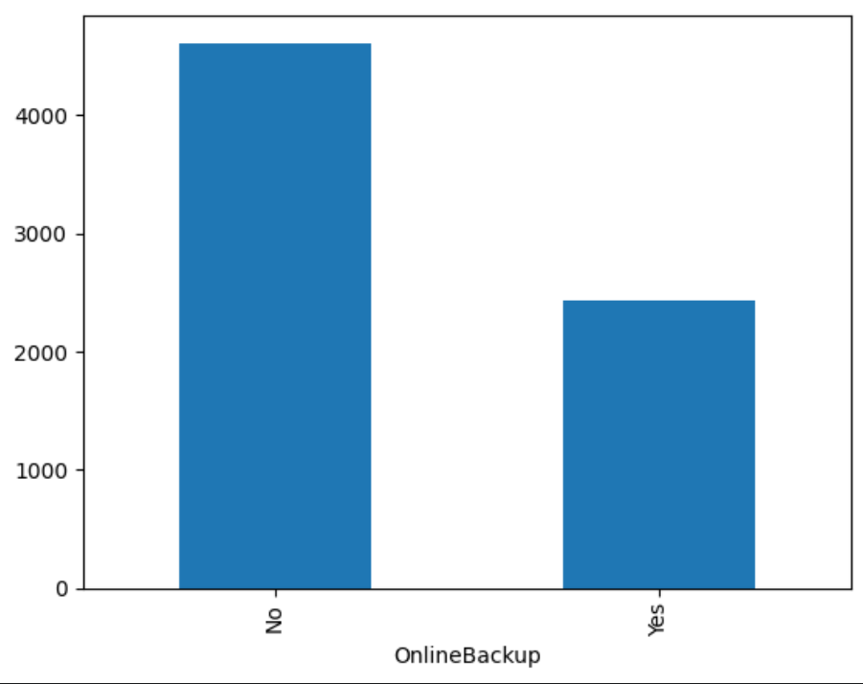
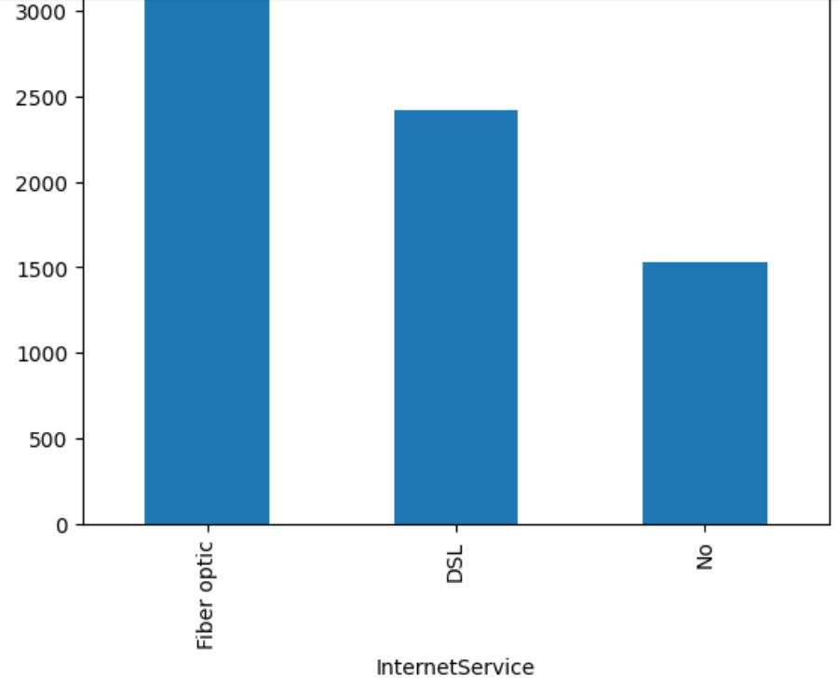
There are more customers not using Online Backup
There are more customers using Fibre Optic than DSL and less customers not using the internet service

Slide 11
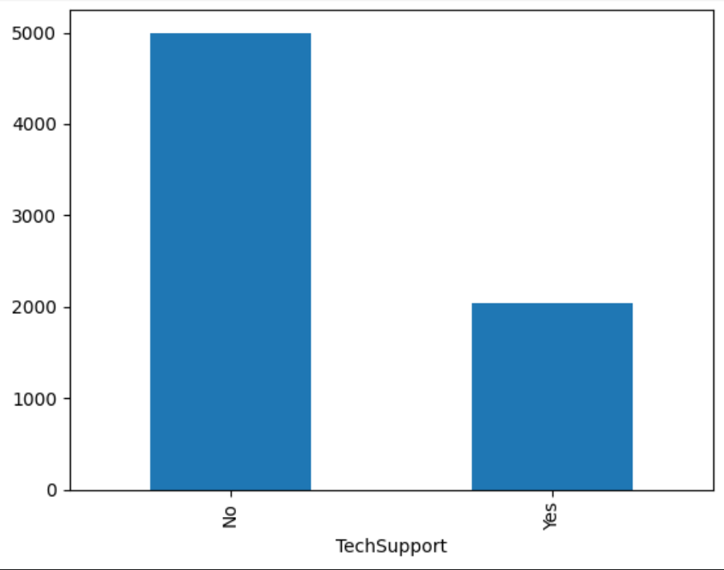
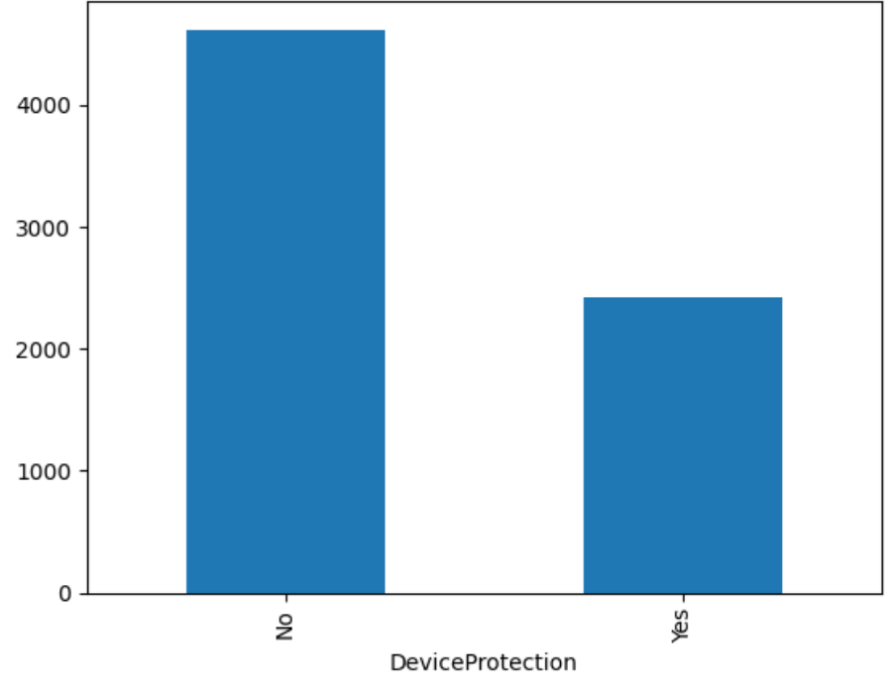
There are more customers that do not require Tech Support
There are more customers that did not subscribe for Device protection

Slide 12
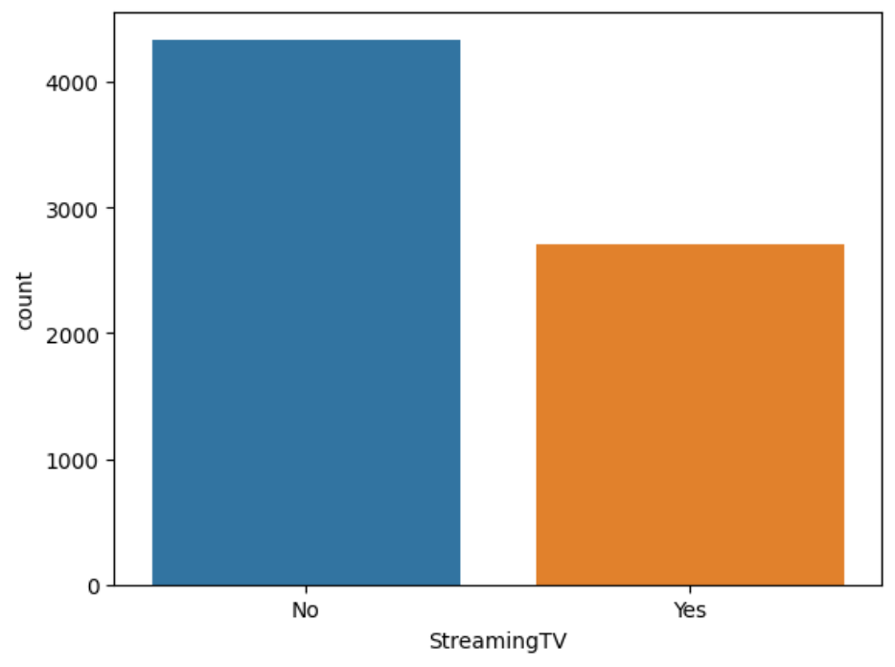
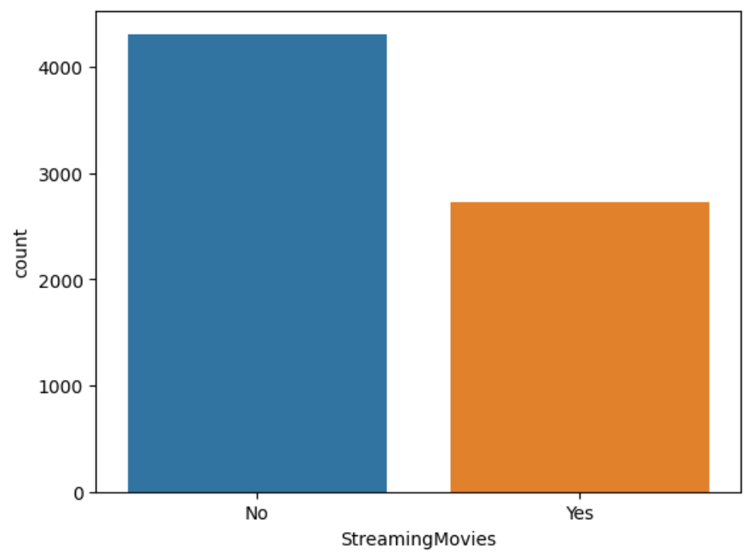
There are less customers using the streaming TV plan
There are less customers using the streaming movies plan

Slide 13
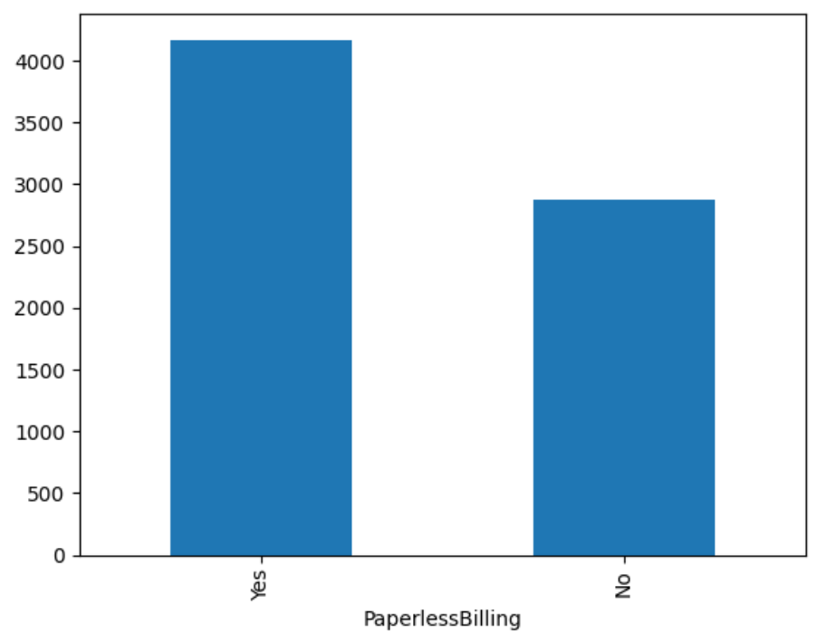
There are more customers using paperless billing

Slide 14
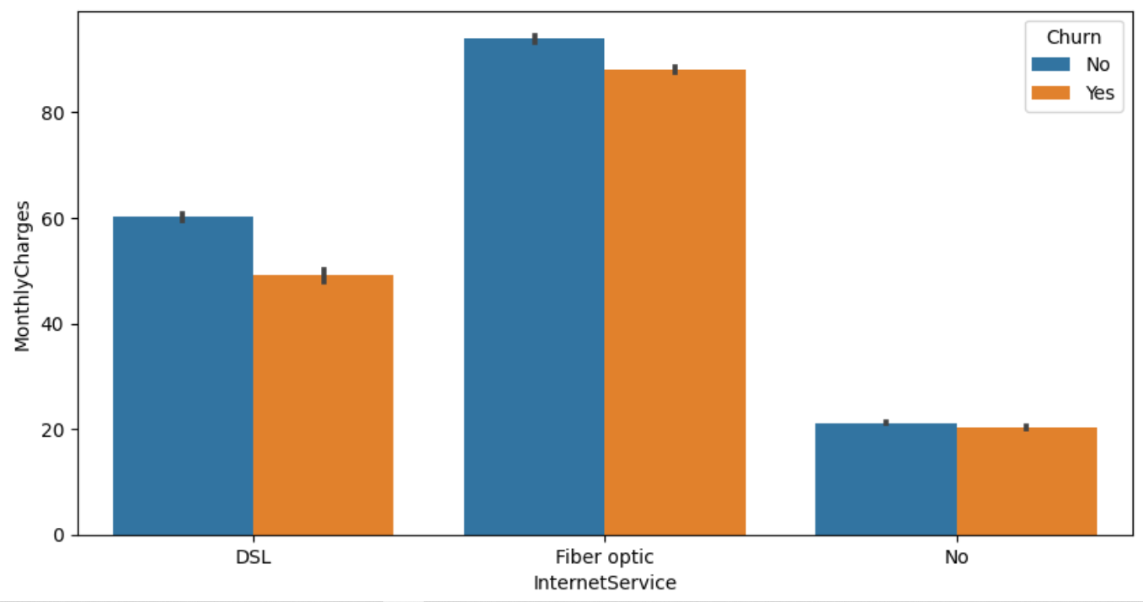
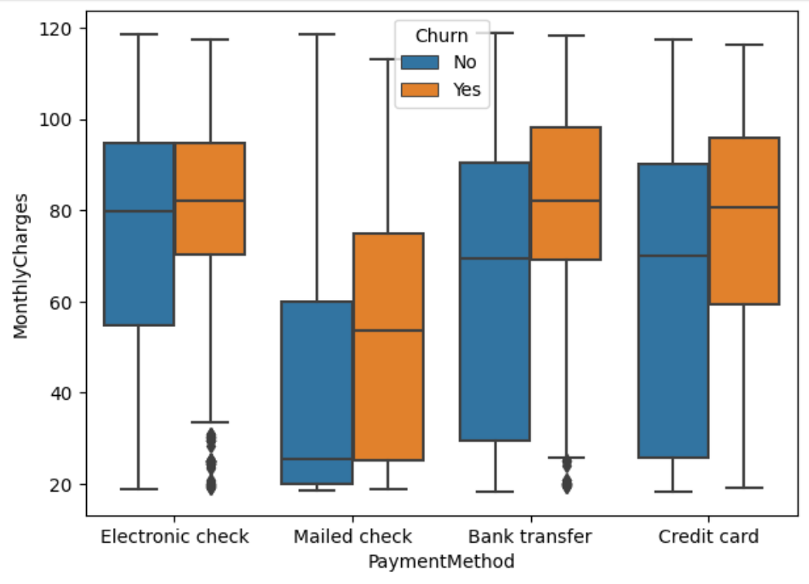
Bivariate Analysis
Studying multiple data together
Customers who subscribe to the fiber optic are more likely to churn
Electronic check, Bank Transfer and Credit card customers monthly charges are high and have a high churn rate

Slide 15
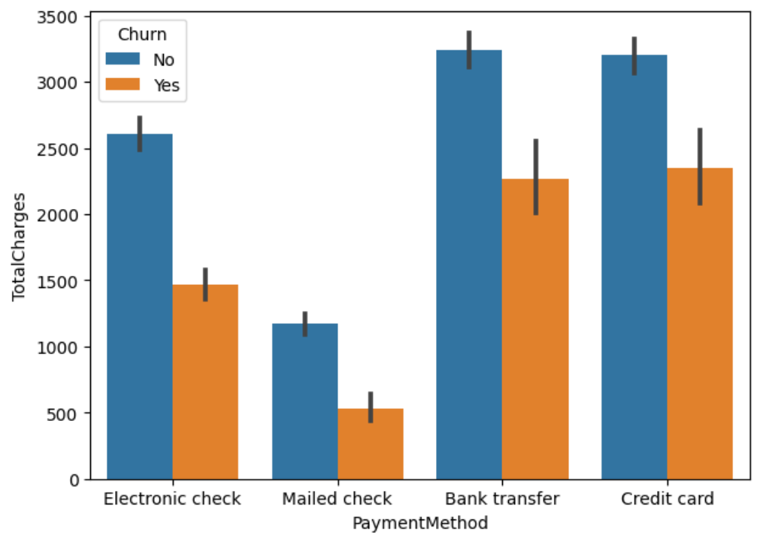
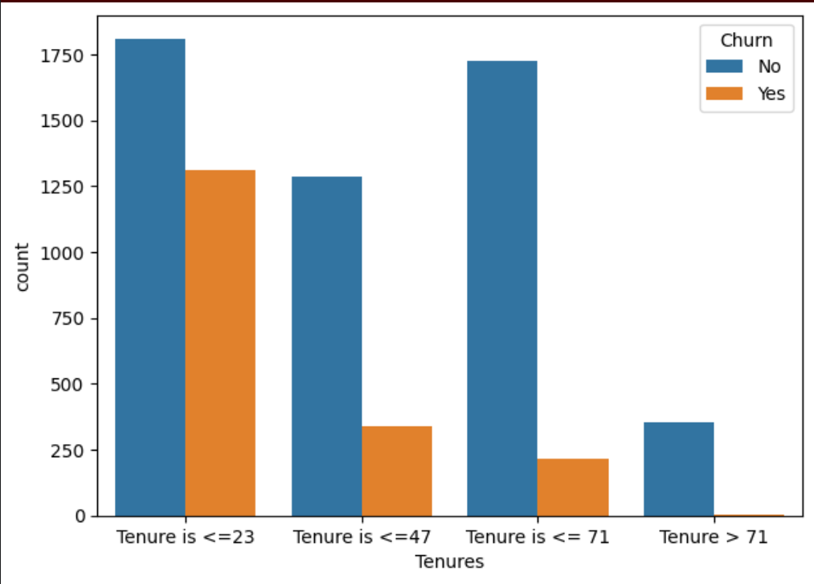
Bank Transfer and Credit Card, Total Charges are high and they have similar churn
Customers are mostly likely deciding to stay or leave within 0 - 23days

Slide 16
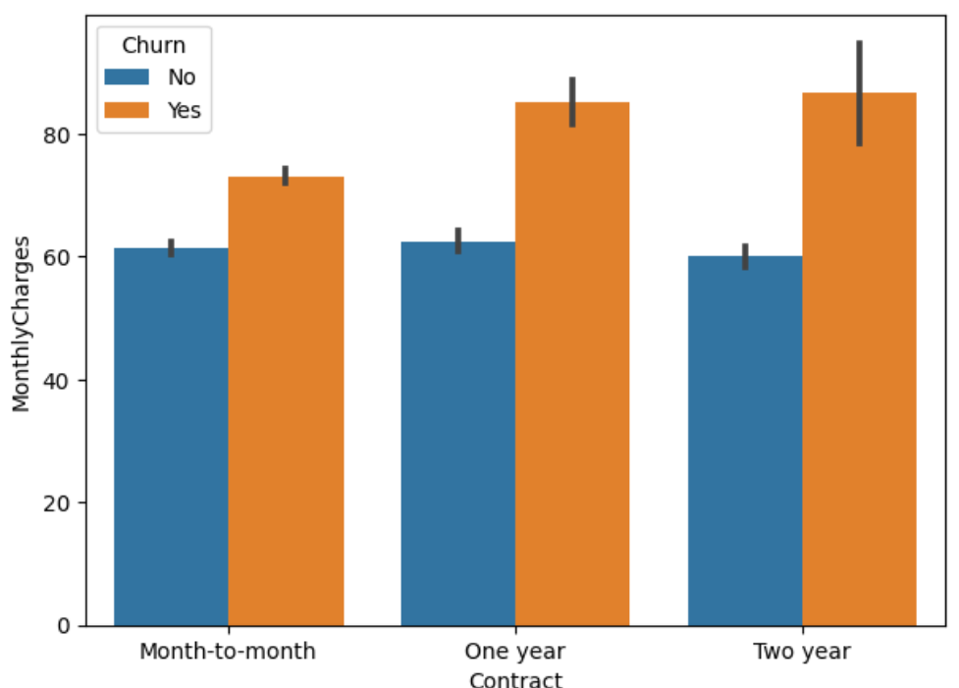
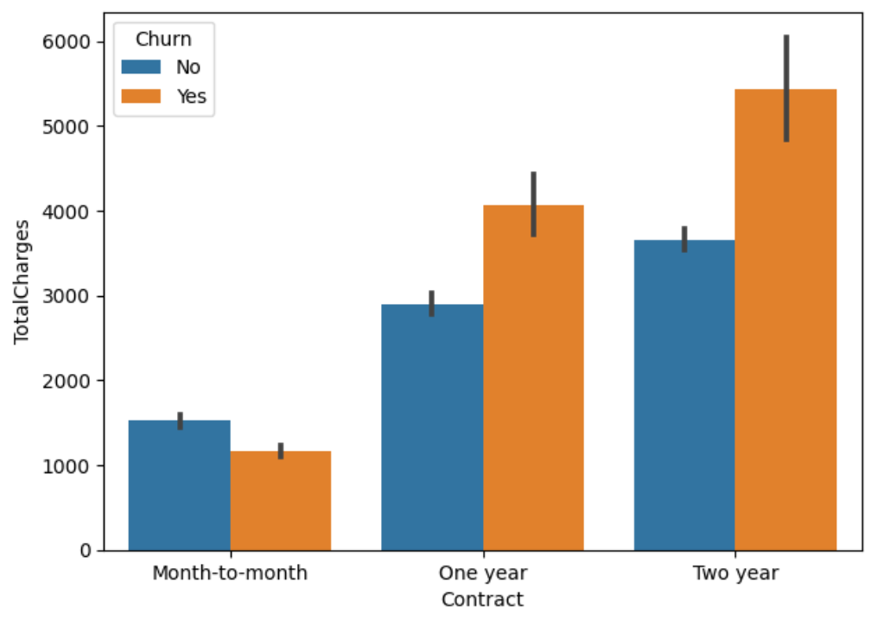
Customers who subscribe to One- and Two-year contract on Monthly Charges have similar churn rate
Customers who subscribe to Two-year contract of total charges are higher and they have the most churn rate

Slide 17
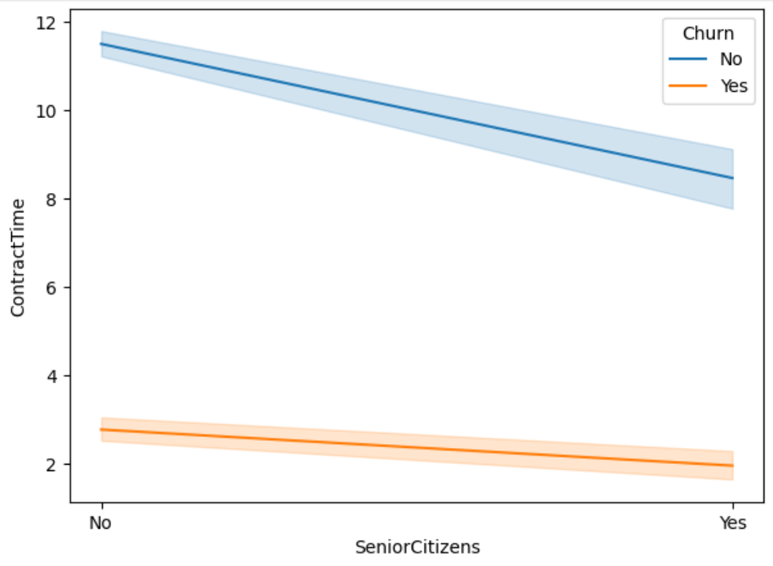
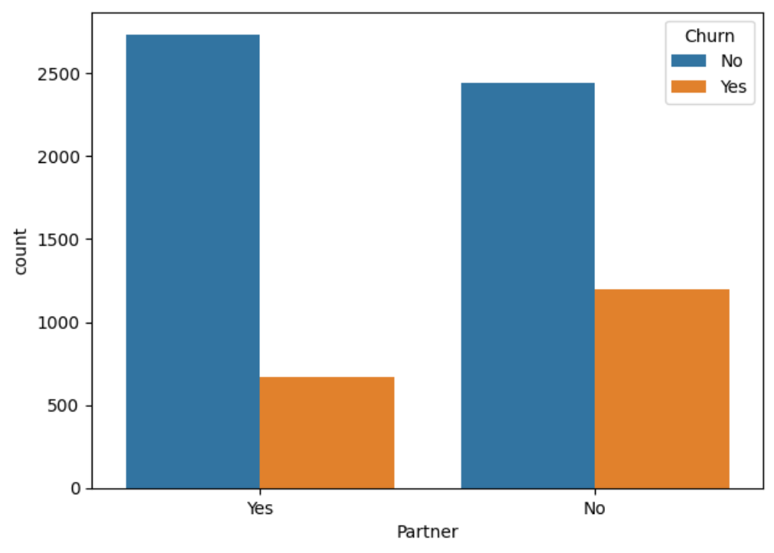
The Senior Citizens are most likely to churn
Customers with no Partners are most likely to Churn

Slide 18
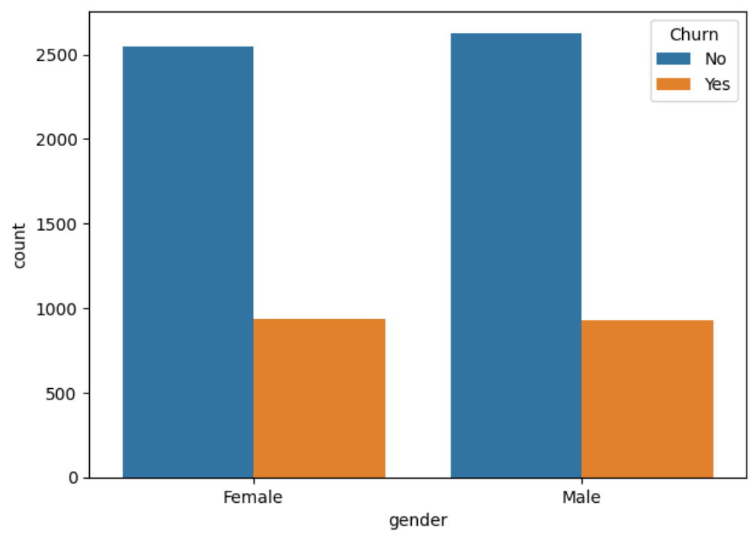
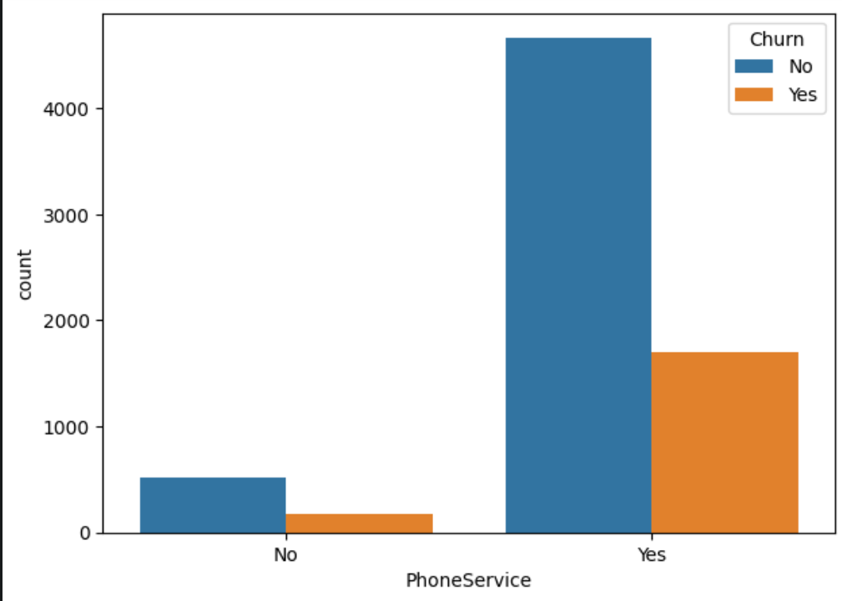
Male and Female are most likely to churn at same rate
Customers who subscribed to Phone Services are most likely to Churn

Slide 19
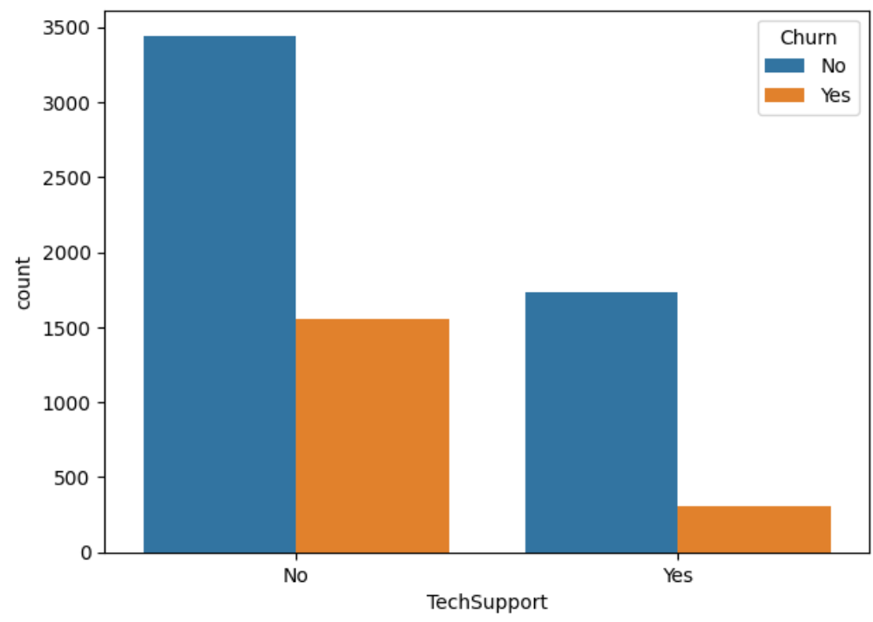
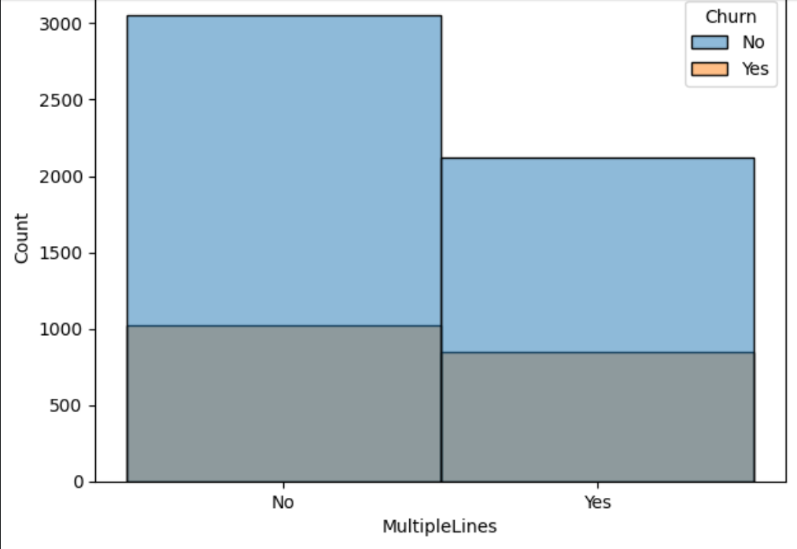
Customer with no Tech support are mostly likely to churn
Customers who do not subscribe to multiple lines are likely to churn

Slide 20
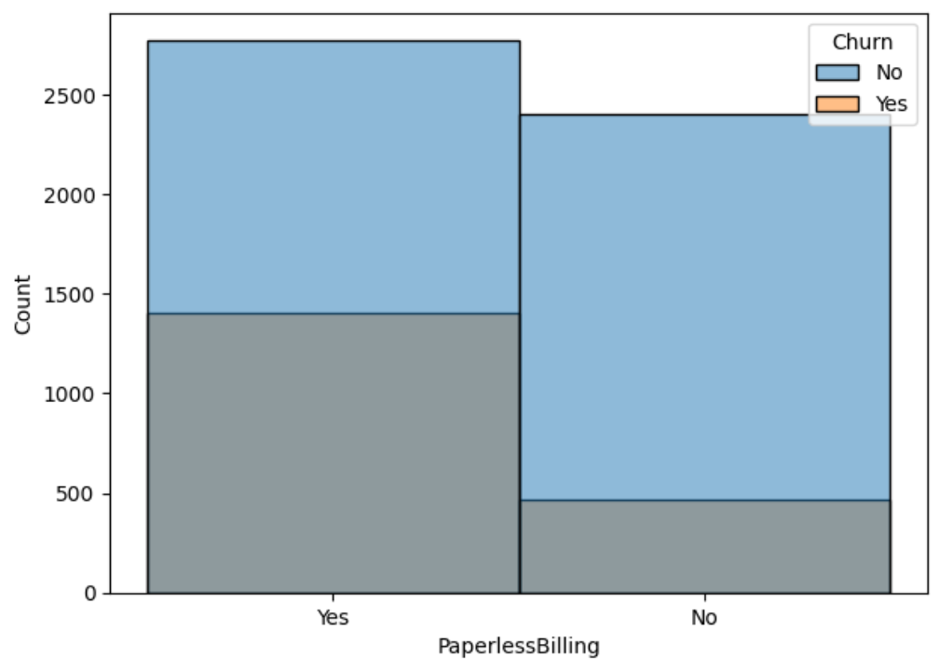
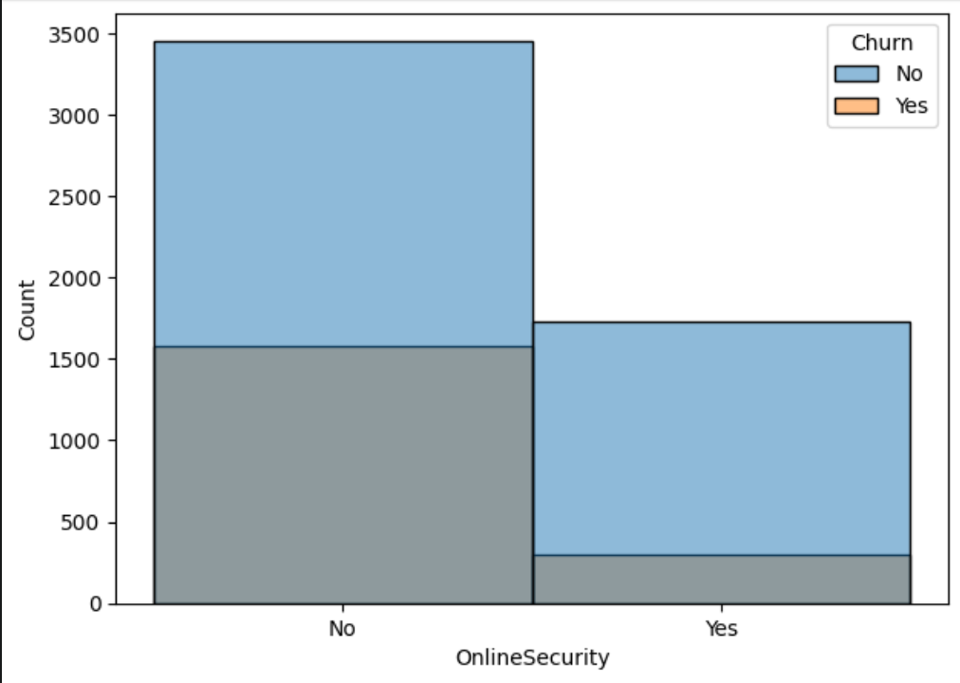
Customer who subscribe to Paperless Billing are mostly likely to churn
Customers without Online Security are mostly likely to churn

Slide 21
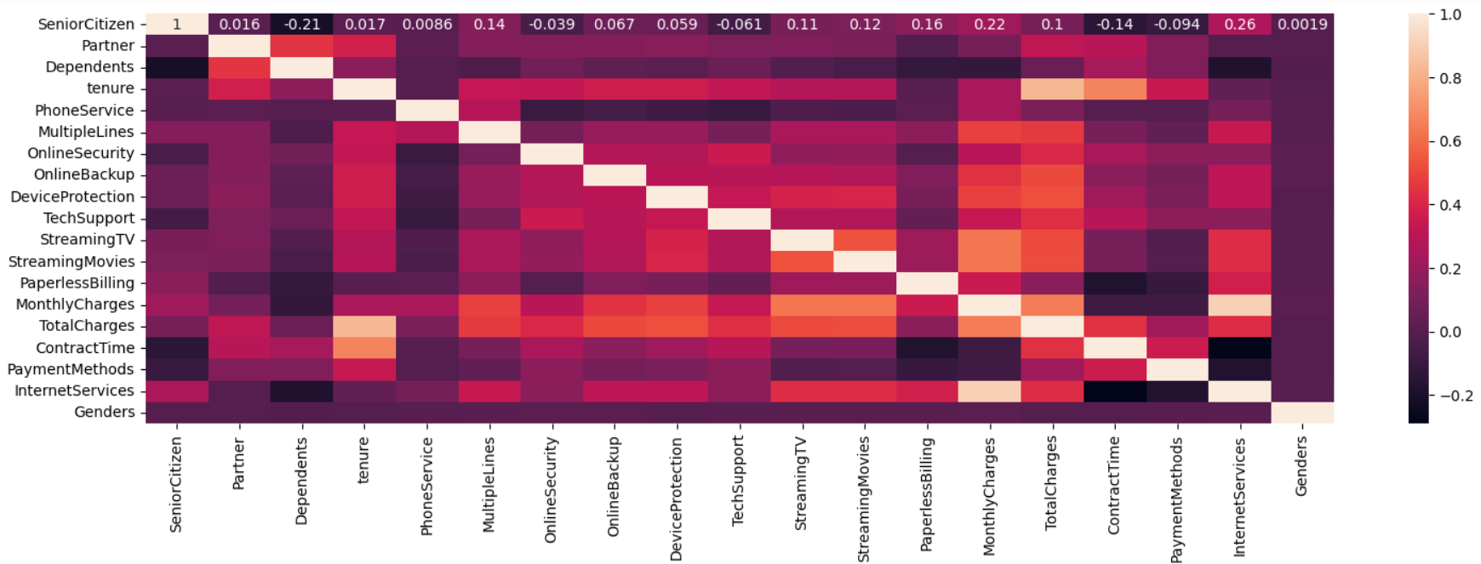
Multivariate Analysis
Studying multiple data at once
There seems to be correlation between Internet Services and Monthly charges, Total charges and Tenure

Slide 22
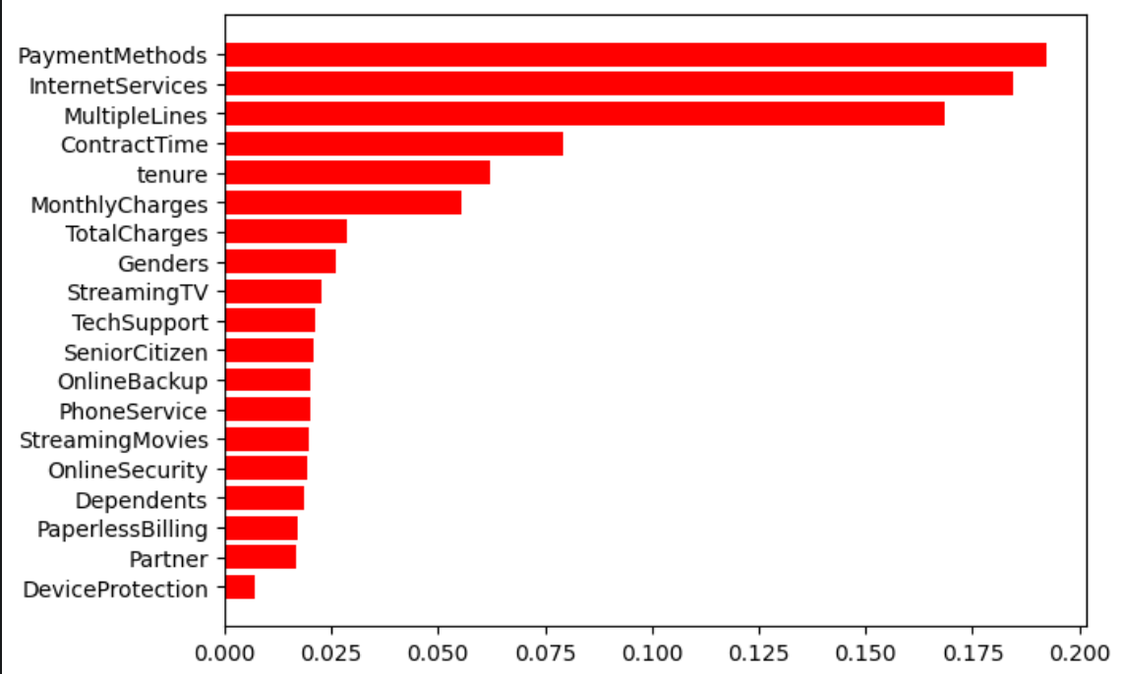
Supervised learning
We used the most important features to train the machine on the churn rate of the customers
The important feature for the training of these model are Payment Methods, InternetService, MultipleLines, ContractInterval, Tenure, Monthly Charges

Slide 23
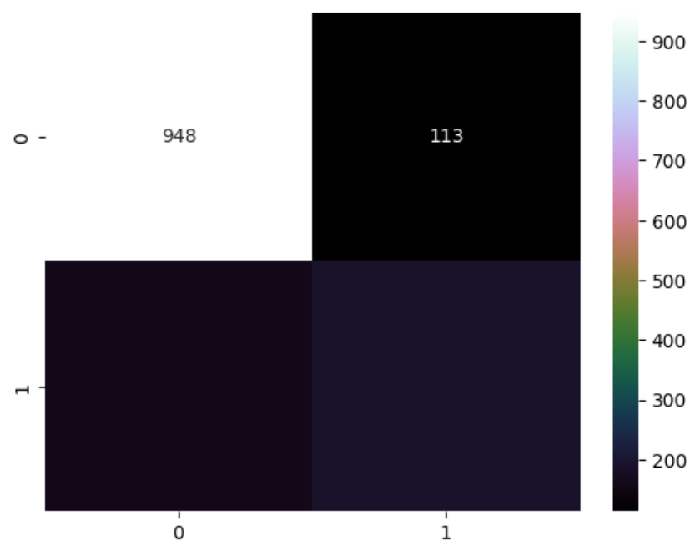
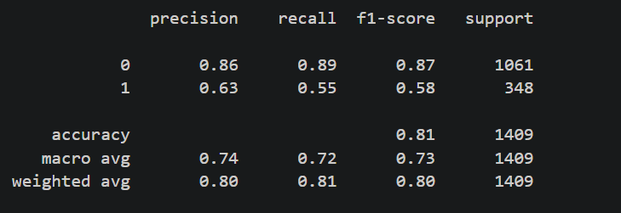
Random Forest Classifier Confusion Matrix and Classification Report

Slide 24
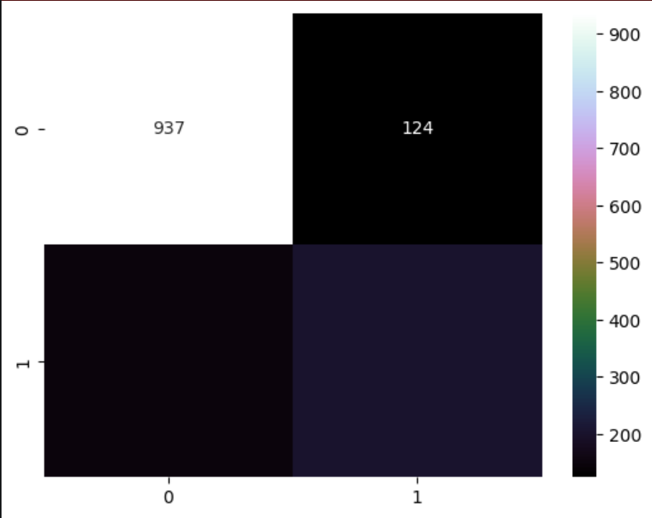
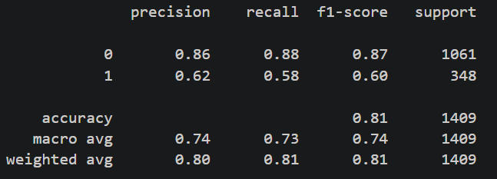
Logistic Regression Confusion Matrix and Classification Report

Slide 25
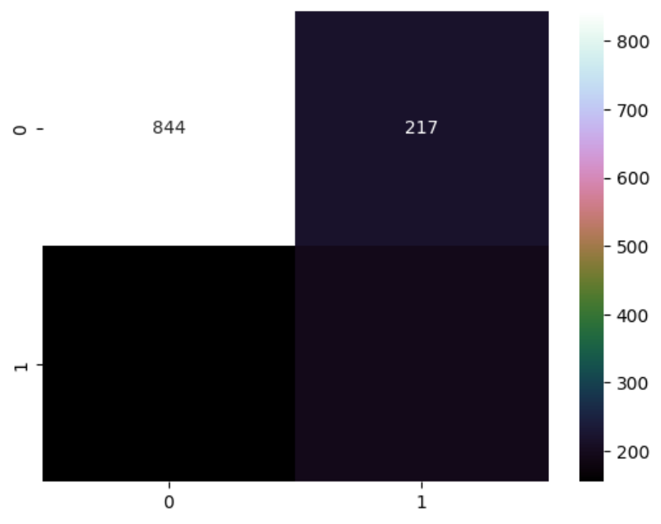
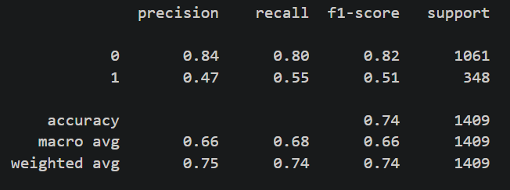
Decision Tree Classifier Confusion Matrix and Classification Report

Slide 26
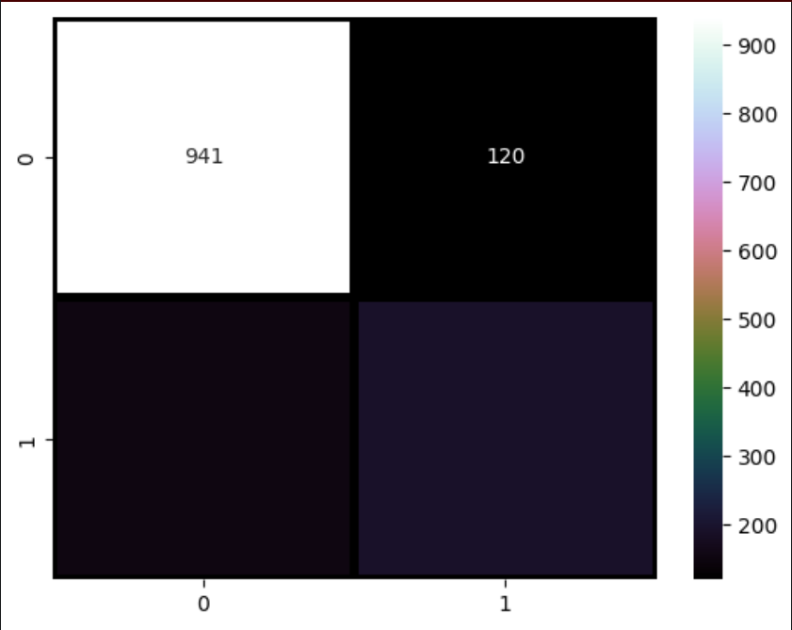
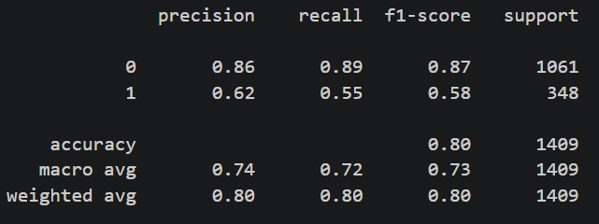
Gradient Booster Classifier Confusion Matrix and Classification Report

Slide 27
Conclusion
Organizations detest customer's churn. However, this is inevitable from the data above there seems to be an amount of customer churning at a certain rate and it will continue due to some certain factors
Recommendation to reduce churning
Create a loyalty scheme for customers with the first 23days for them to stay longer
Incentivize Senior Citizens to make them stay longer on the platform
Create discounts for customers paying high charges on total charges with one and two years contract to reduce churn rate
More Information should be shared or given above Paperless Billings

